Slide 1
EVENT MANAGEMENT SYSTEM
Submitted By: Nisha Paunikar

Slide 2
INDEX
INTRODUCTION
PROBLEM STATEMENT
PROJECT OBJECTIVES
ER DIAGRAM
TOOLS & TECHNOLOGIES
CHALLENGES FACED
CONCLUSION

Slide 3

INTRODUCTION
Event Management System is a project which aims in developing a computerized system to manage all the daily activities of event handling such as creating events, managing venues, booking tickets, sending confirmation mails, and maintaining all records using Java, JDBC, SQL, and JavaMail API.

Slide 4

PROBLEM STATEMENT
Traditional event booking has many challenges:
Manual registration process
No proper record management
Hard to track bookings and cancellations
No centralized system
This project solves these issues using a simple, database-driven console application.

Slide 5

PROJECT OBJECTIVES
Provide a system for managing events and venues
Allow participants to book and cancel tickets
Maintain clean database records
Enable admin control for event management
Use JDBC for secure database connectivity

Slide 6
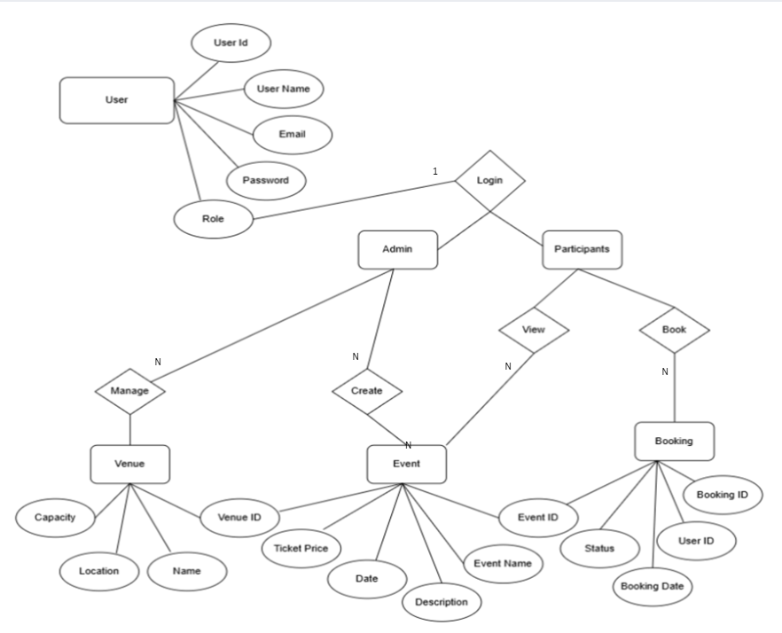
ER DIAGRAM

Slide 7




TOOLS & TECHNOLOGIES
JDBC Driver
SQL Database
Core Java
Eclipse IDE

Slide 8

CHALLENGES FACED
Handling SQL exceptions
Designing multiple Java modules
Implementing CRUD operations
Configuring JavaMail API with SMTP server
Sending real-time confirmation and cancellation emails

Slide 9
CONCLUSION
Built a fully functional console-based Event Management System
Covers event creation, booking, cancellation, and venue management
Uses clean Java code and efficient JDBC interactions
Database ensures accuracy and reliability

Slide 10


